Slide 1
Principles of Programming Language
Amit Dua
Computer Science and Information Systems Department
BITS, Pilani

Slide 2
Lambda Calculus
Lecture slides courtesy Prof. Sriram Rajamani, Prof. Adam Doupe, and Prof. Gabriel Lebec
Lecture material from Reference book titled “Types and programming languages” by Benjamin C. Pierce

Slide 3
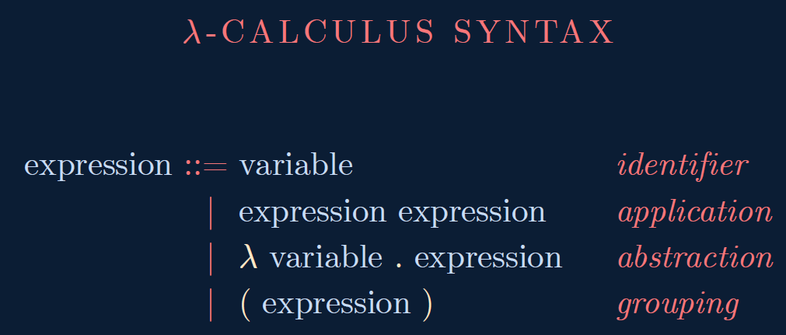

Slide 4
Disambiguation Rules
E → E E is left associative
x y z is
(x y) z
w x y z is
((w x) y) z
λ ID . E extends as far to the right as possible, starting with the λ ID .
λ x . x y is
λ x . (x y)
λ x . λ x . x is
λ x. ( λ x . x)

Slide 5
Take away from Last couple of classes
New programming language – Lambda calculus
Syntax
Scope
Renaming and Reduction
Call by value and name

Slide 6
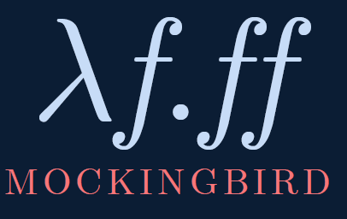
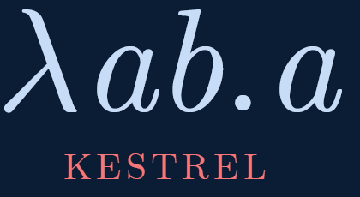
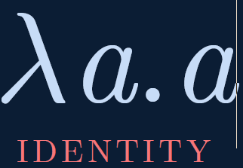
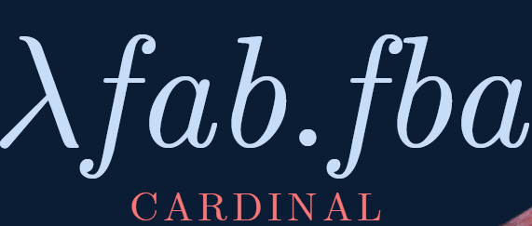
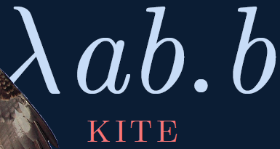
Combinators

Slide 7
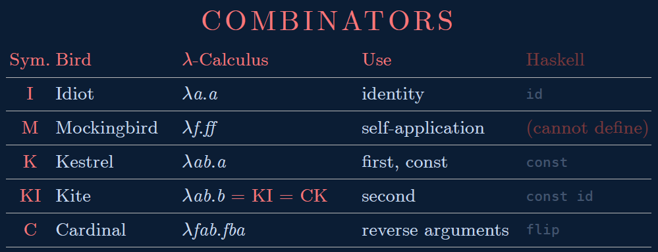

Slide 8
Boolean Logic
T = (λ x . λ y . x)
F = (λ x . λ y . y)
and = (λ a . λ b . a b F)
and T T
(λ a . λ b . a b (λ x . λ y . y))

Slide 9
not
not T = F
not F = T
not = (λ a . a F T)
not T
(λ a . a F T) T
T F T
F
not F
(λ a . a F T) F
F F T
T

Slide 10
If Branches
if c then
a
else
b
if c a b
if T a b = a
if F a b = b
if = (λ a . a)

Slide 11
Examples
if T a b
(λ a . a) T a b
T a b
a
if F a b
(λ a . a) F a b
F a b
b

Slide 12
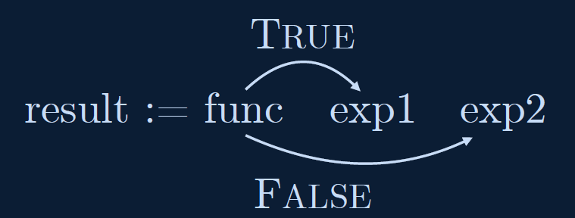
const result = bool ? exp1 : exp2
result := bool ? exp1 : exp2
result := bool exp1 exp2
result := func exp1 exp2

Slide 13
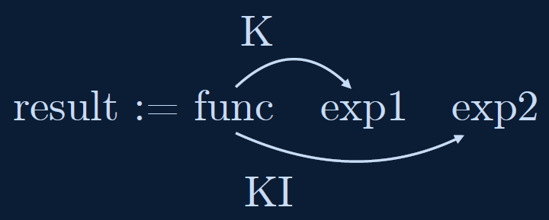
TRUE := K
FALSE := KI = C K

Slide 14
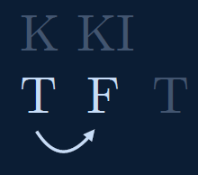
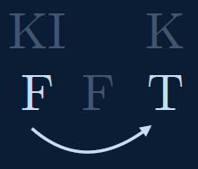
NOT
NOT := 𝜆p.pFT

Slide 15
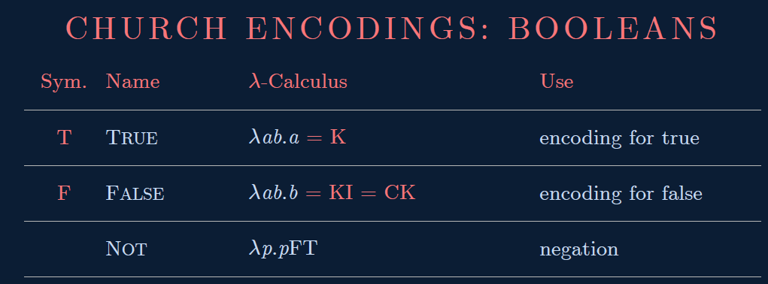

Slide 16
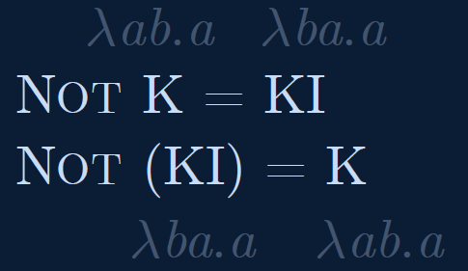
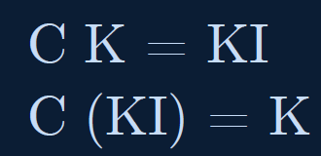
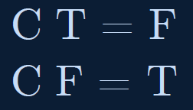

Slide 17
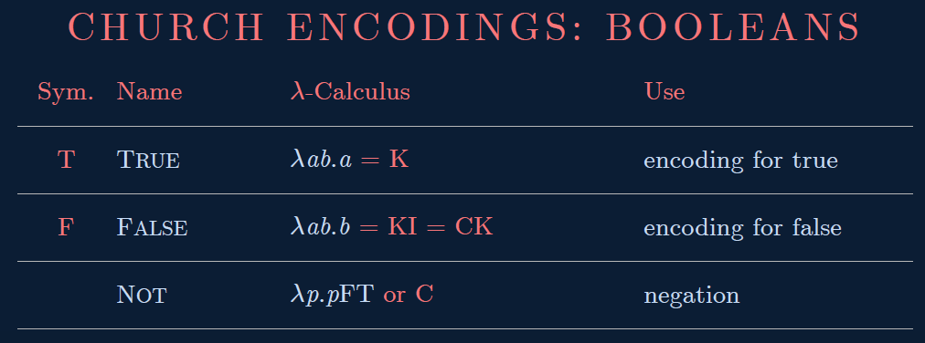

Slide 18
Church's Numerals
0 = λ f . λ x . x
1 = λ f . λ x . f x
2 = λ f . λ x . f (f x)
3 = λ f . λ x . f (f (f x))
4 = λ f . λ x . f (f (f (f x)))
λ f . λ x . (f (f (f (f x))))
4 a b
a (a (a (a b)))

Slide 19
Successor Function
succ = λ n . λ f . λ x . f (n f x)
0 = λ f . λ x . x
succ 0
(λ n . λ f . λ x . f (n f x)) 0
λ f . λ x . f (0 f x)
λ f . λ x . f ((λ f . λ x . x) f x)
λ f . λ x . f x
1 = λ f . λ x . f x
succ 0 = 1

Slide 20
Successor Function
succ = λ n . λ f . λ x . f (n f x)
1 = λ f . λ x . f x
succ 1
(λ n . λ f . λ x . f (n f x)) 1
λ f . λ x . f (1 f x)
λ f . λ x . f ((λ f . λ x . f x) f x)
λ f . λ x . f (f x)
2 = λ f . λ x . f (f x)
succ 1 = 2
succ n = n + 1

Slide 21
Addition
add 0 1 = 1
add 1 2 = 3
add = λ n . λ m . λ f . λ x . n f (m f x)
add 0 1
(λ n . λ m . λ f . λ x . n f (m f x)) 0 1
(λ m . λ f . λ x . 0 f (m f x)) 1
λ f . λ x . 0 f (1 f x)
λ f . λ x . 0 f (f x)
λ f . λ x . f x

Slide 22
Addition
add = λ n . λ m . λ f . λ x . n f (m f x)
add 1 2
(λ n . λ m . λ f . λ x . n f (m f x)) 1 2
(λ m . λ f . λ x . 1 f (m f x)) 2
λ f . λ x . 1 f (2 f x)
λ f . λ x . 1 f (f (f x))
λ f . λ x . (f (f (f x)))
3

Slide 23
So Far
How to express
Combinators ✓
Boolean expression ✓
Numbers ✓
addition ✓
multiplication
recursion

Slide 24
Multiplication
mult 0 1 = 0
mult 1 2 = 2
mult 2 5 = 10
mult = λ n . λ m . m (add n) 0
mult 0 1
(λ n . λ m . m (add n) 0) 0 1
(λ m . m (add 0) 0) 1
1 (add 0) 0
add 0 0
0

Slide 25
Multiplication
mult 1 2
(λ n . λ m . m (add n) 0) 1 2
(λ m . m (add 1) 0) 2
2 (add 1) 0
(add 1) ((add 1) 0)
(add 1) (add 1 0)
(add 1) (1)
(add 1 1)
2

Slide 26
Factorial
n!
fact(0) = 1
fact(n) = n * fact(n-1)
int fact(int n)
{
if (n == 0)
{
return 1;
}
return n * fact(n-1);
}

Slide 27
Factorial
(assuming that we have definitions of the iszero and pred functions)
fact = (λ n . if (iszero n) (1) (mult n (fact (pred n)))
However, we cannot write this function!

Slide 28
Y Combinator
Y = (λ x . λ y . y (x x y)) (λ x . λ y . y (x x y))
Y foo
(λ x . λ y . y (x x y)) (λ x . λ y . y (x x y)) foo
(λ y . y ((λ x . λ y . y (x x y)) (λ x . λ y . y (x x y)) y)) foo
foo ((λ x . λ y . y (x x y)) (λ x . λ y . y (x x y)) foo)
foo (Y foo)
foo (foo (Y foo))
foo (foo (foo (Y foo)))
…

Slide 29
Recursion
fact = (λ n . if (iszero n) (1) (mult n (fact (pred n)))
fact = Y (λ f . λ n . if (iszero n) (1) (mult n (f (pred n)))
fact 1
Y (λ f . λ n . if (iszero n) (1) (mult n (f (pred n))) 1
(λ f . λ n . if (iszero n) (1) (mult n (f (pred n))) (Y (λ f . λ n . if (iszero n) (1) (mult n (f (pred n))) 1
(λ n . if (iszero n) (1) (mult n ((Y (λ f . λ n . if (iszero n) (1) (mult n (f (pred n))) (pred n))) 1
if (iszero 1) (1) (mult 1 ((Y (λ f . λ n . if (iszero n) (1) (mult n (f (pred n))) (pred 1))
if F (1) (mult 1 ((Y (λ f . λ n . if (iszero n) (1) (mult n (f (pred n))) (pred 1))
mult 1 ((Y (λ f . λ n . if (iszero n) (1) (mult n (f (pred n))) (pred 1)
mult 1 (λ f . λ n . if (iszero n) (1) (mult n (f (pred n))) (Y (λ f . λ n . if (iszero n) (1) (mult n (f (pred n))) (pred 1)
mult 1 (λ n . if (iszero n) (1) (mult n ((Y (λ f . λ n . if (iszero n) (1) (mult n (f (pred n))) (pred n))) (pred 1)
mult 1 (λ n . if (iszero n) (1) (mult n ((Y (λ f . λ n . if (iszero n) (1) (mult n (f (pred n))) (pred n))) 0
mult 1 (if (iszero 0) (1) (mult 0 ((Y (λ f . λ n . if (iszero n) (1) (mult n (f (pred n))) (pred 0)))
mult 1 if T (1) (mult 0 ((Y (λ f . λ n . if (iszero n) (1) (mult n (f (pred n))) (pred 0)))
mult 1 1
1

Slide 30
So
How to express
Combinators ✓
Boolean expression ✓
Numbers ✓
addition ✓
multiplication ✓
recursion ✓

